Slide 1
NumPy Tutorial

Slide 2
What and Why NumPy?
NumPy is a Python library used for working with arrays.
It also has functions for working in domain of linear algebra, fourier transform, and matrices.
NumPy was created in 2005 by Travis Oliphant. It is an open source project and you can use it freely.
NumPy stands for Numerical Python.
In Python we have lists that serve the purpose of arrays, but they are slow to process.
NumPy aims to provide an array object that is up to 50x faster than traditional Python lists.

Slide 3
Installation of NumPy
pip install numpy
Checking NumPy Version
print(np.__version__)
Import NumPy
import numpy as np

Slide 4
Create a NumPy ndarray Object
NumPy is used to work with arrays. The array object in NumPy is called ndarray.
create a NumPy ndarray object by using the array() function.
import numpy as np arr = np.array([1, 2, 3, 4, 5]) print(arr) print(type(arr))

Slide 5
Dimensions in Arrays
a = np.array(42) b = np.array([1, 2, 3, 4, 5]) c = np.array([[1, 2, 3], [4, 5, 6]]) d = np.array([[[1, 2, 3], [4, 5, 6]], [[1, 2, 3], [4, 5, 6]]])
print(a.ndim), print(b.ndim), print(c.ndim), print(d.ndim)
NumPy Arrays provides the ndim attribute that returns an integer that tells us how many dimensions the array have.

Slide 6
Higher Dimensional Arrays
import numpy as np arr = np.array([1, 2, 3, 4], ndmin=5) print(arr) print('number of dimensions :', arr.ndim)

Slide 7
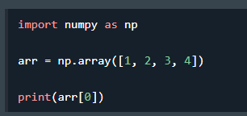
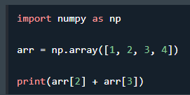
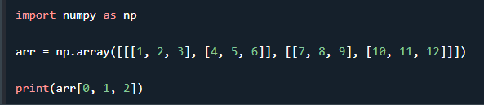
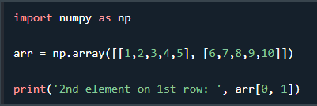
NumPy Array Indexing
Array indexing is the same as accessing an array element.
You can access an array element by referring to its index number.

Slide 8
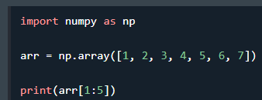
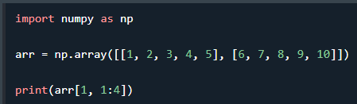
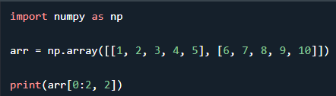
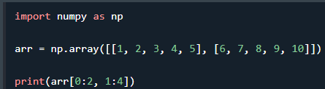
NumPy Array Slicing

Slide 9
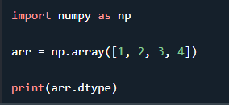
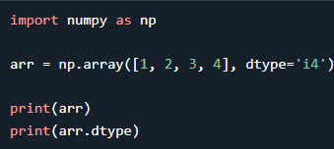
Checking the Data Type of an Array
The NumPy array object has a property called dtype that returns the data type of the array
Creating Arrays With a Defined Data Type

Slide 10
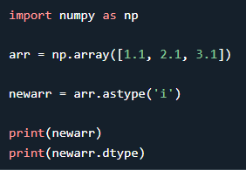
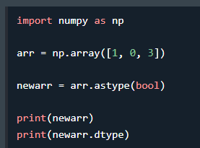
Converting Data Type on Existing Arrays
change the data type of an existing array, is to make a copy of the array with the astype() method.

Slide 11
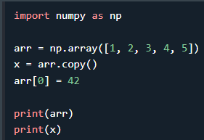
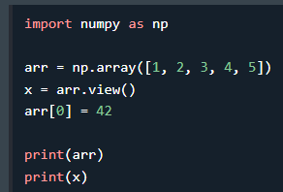
NumPy Array Copy vs View
The main difference between a copy and a view of an array is that the copy is a new array, and the view is just a view of the original array.
The copy owns the data and any changes made to the copy will not affect original array, and any changes made to the original array will not affect the copy.
The view does not own the data and any changes made to the view will affect the original array, and any changes made to the original array will affect the view.

Slide 12
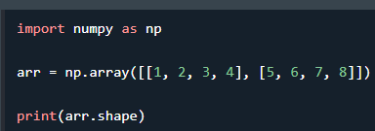
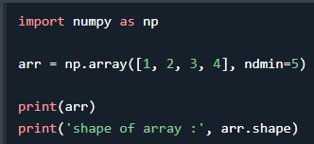
NumPy Array Shape

Slide 13
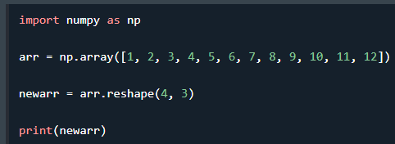
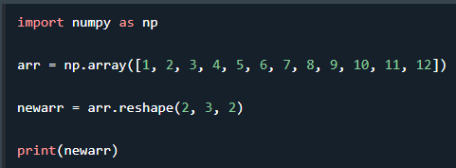
NumPy Array Reshaping

Slide 14
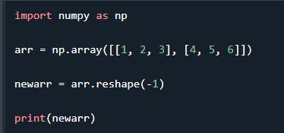
Flattening the arrays
Flattening array means converting a multidimensional array into a 1D array.
use reshape(-1) .

Slide 15
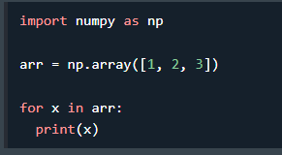
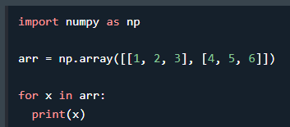
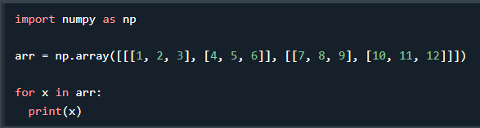
NumPy Array Iterating

Slide 16
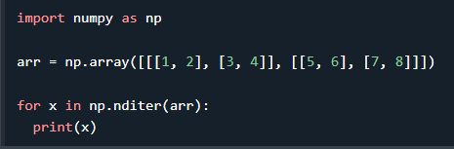
Iterating Arrays Using nditer()

Slide 17
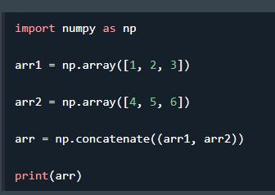
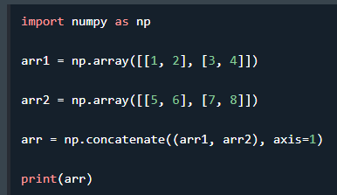
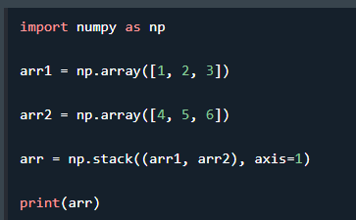
NumPy Joining Array

Slide 18
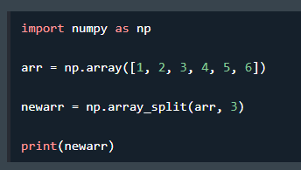
NumPy Splitting Array

Slide 19
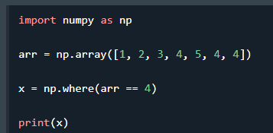
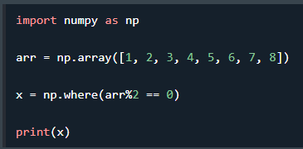
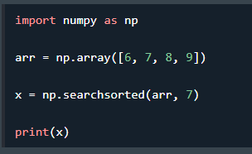
NumPy Searching Arrays

Slide 20
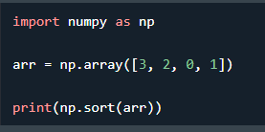
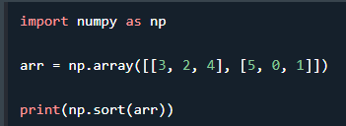
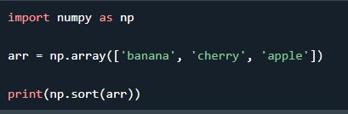
NumPy Sorting Arrays

